Slide 1
BodPost (AI Based Real-Time Body Posture Detection)
End-to-End Machine Learning Project by Sachin Kumar
GitHub: https://github.com/devsachink22/BodPost

Slide 2
Problem Statement (BodPost)
Poor posture leads to back pain, fatigue, and musculoskeletal disorders.
  Manual posture monitoring is inefficient.
  Need for a real-time, AI-based posture detection system.
  BodPost automates posture detection using computer vision and ML.

Slide 3
Proposed Solution (BodPost)
AI-powered system for classifying posture in real-time.
  Uses MediaPipe for pose estimation.
  Extracts posture features from body landmarks.
  Uses Machine Learning to classify posture as Correct or Incorrect.

Slide 4
Data Collection
I clicked around 840 images with different pose and angles to prepare an unlabeled dataset & further split those images into two categories – Correct & Incorrect.

Slide 5
Feature Engineering (Images to CSV)
Detects 33 human body landmarks from each image using mediapipe
Extracts x-coordinate, y-coordinate and visibility score from each landmark
Stores them into a row in CSV

Slide 6
Model Training (Random Forest Binary Classification)
Loading Dataset
Selecting Features and Labels.
Train/Test Split
Preprocessing (Standard Scaler & Label Encoding)
Model Selection (Random Forest Classification)
Hyperparameters Optimization using GridSearch CV
Model Evaluation
Saving trained model and selected features

Slide 7
Real Time Posture Detection
Open web camera
Extract real time human body landmarks from each frame
Convert real time landmarks into feature vectors in exact same order as model was trained
Feeds them into trained model to predict:
  - Correct Posture (0)
  - Incorrect Posture (1)
Display status as text + color overlay on web camera feed

Slide 8
Random Forest Classification
Random Forest Classification is an ensembled machine learning algorithm that combines multiple decision trees to make accurate and stable prediction.
Why Random?
Random Sampling of Features (max_features, min_features)
Random Sampling of Data (Bootstrap)
Why Forest?
Because it trains many trees, not just one.

Slide 9
Hyperparameters & GridSearch CV
Hyperparameters is a core part of machine learning that deals with overfit or underfit data.
GridSearch Cross Validation is a brute force searching technique that uses all the combinations of defined hyperparameters to find the best once for the given dataset.

Slide 10
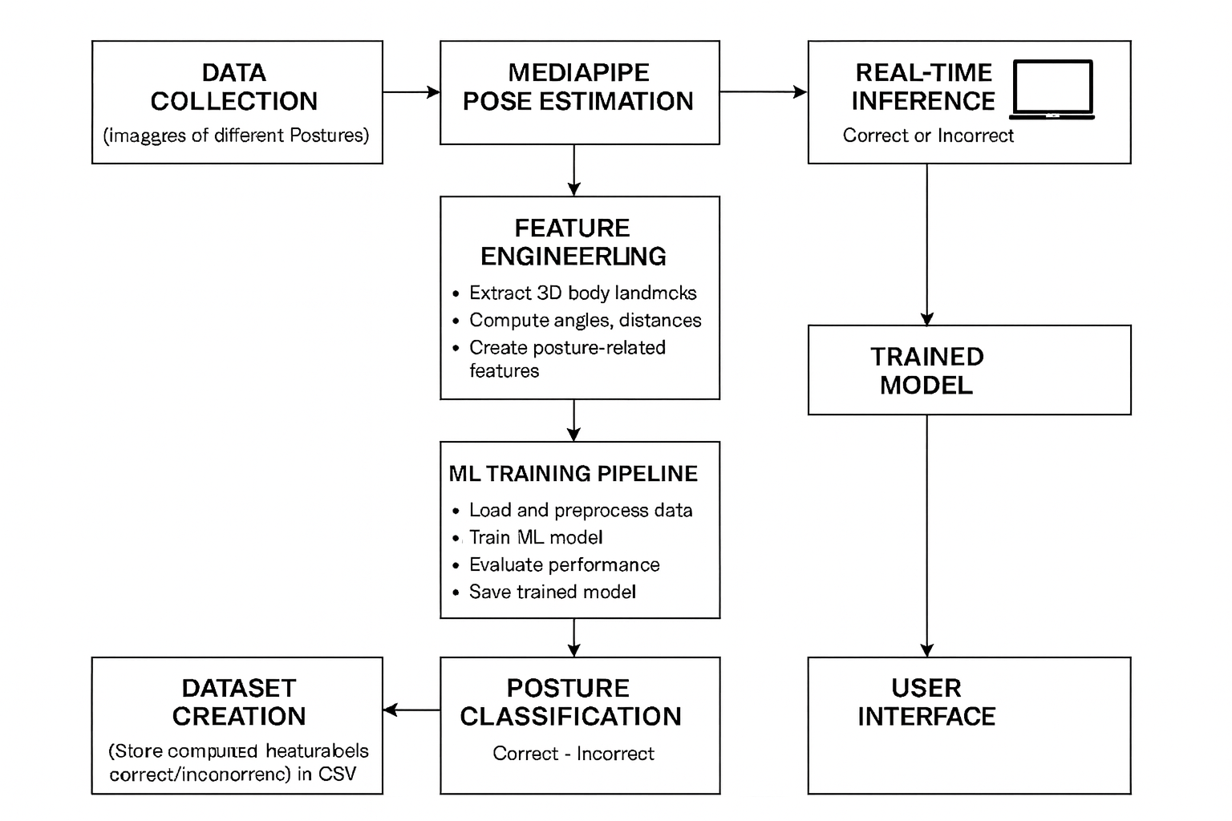
Full System Architecture

Slide 11
Model Performance (Classification Report)
Confusion matrix:
[[56 1]
[ 2 85]]
Best Accuracy: 0.9896
Test set performance:
precision recall f1-score support
class_0 0.97 0.98 0.97 57
class_1 0.99 0.98 0.98 87
accuracy 0.98 144
macro avg 0.98 0.98 0.98 144
weighted avg 0.98 0.98 0.98 144

Slide 12
Applications & Future Scope
Fitness and exercise posture correction.
Medical rehabilitation assistance.
Multi-class posture detection in future.
Posture scoring and alert system.

Slide 13
Future Enhancements
Convert this binary classification model into multi classification model
Add ergonomic risk scoring system
Add cloud dashboard for posture logging
Deploy model as a web app (Flask/FastAPI)
Add pose-correction suggestions using vector geometry
Integrate with wearable devices

Slide 14
Thank You https://www.linkedin.com/in/devsachink22/

